Slide 1
Oscar Winners
Group 4
By: Michael Overman, Sose Ehize, Coral Tracy, & Nicolas Brunetto

Slide 2
Introduction
Each row of the dataset states the best actor/ actress from 1929-2018. If there is a tie, that makes there an extra winner for that year.
Data sets. (n.d.). https://www.openintro.org/data/index.php?data=oscars

Slide 3
Details
This is a sample of the winners for Best Actor and Best Actress in the Oscar’s from 1929 to 2018. It is not a full population, as there will be further Oscar awards in the future, as well as there being other awards besides Best Actor/Actress that are not covered herein.
The full dataset contains 182 observations of 10 variables. Our report is concerned with 7 of these variables for each observation.

Slide 4
Variables
age - a numerical, continuous variable.
oscar_yr - the year the Oscar was awarded. This is a numerical, discrete variable.
birth_y - the year the award-winning actor/actress was born. This is a numerical, discrete variable.
award - either 'Best Actor' or 'Best Actress'. This is a categorical variable.
birth_pl - the location the actor/actress was born. This is a categorical variable.
movie - the film the actor/actress won their Oscar for. This is a categorical variable.
name - the name of the award-winning actor/actress. This is a categorical variable.

Slide 5
Question
Is there a difference in the average age between 'Best Actor' and 'Best Actress’?

Slide 6
Hypotheses
μ_actress = mean age of 'Best Actress'
μ_actor = mean age of 'Best Actor'
Null hypothesis: There is no difference in average age between 'Best Actor' and 'Best Actress'.
H₀: μ_actress = μ_actor
Alternative hypothesis: There is a difference in average age between 'Best Actor' and 'Best Actress'.
Hₐ: μ_actress ≠ μ_actor

Slide 7
Statistical Errors
Type 1 error: Concluding that there is a difference in average age of Best Actress and Best Actor, when there is no difference.
Type 2 error: Concluding that there is no difference in average age of Best Actress and Best Actor, when there is a difference.
A Type 1 error would be worse, because an incorrect conclusion that there are gender-based differences in the filmmaking industry could lead to ungrounded claims of gender bias in the industry, thereby leading to attempts to fix a problem that might not exist.

Slide 8


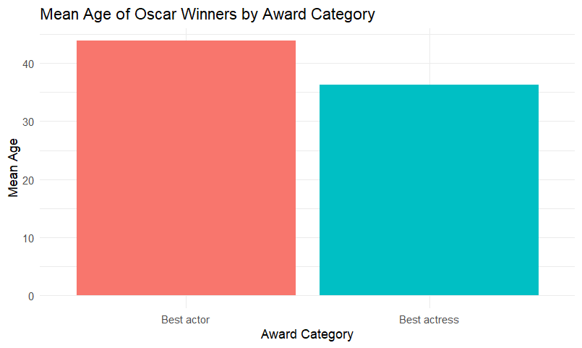
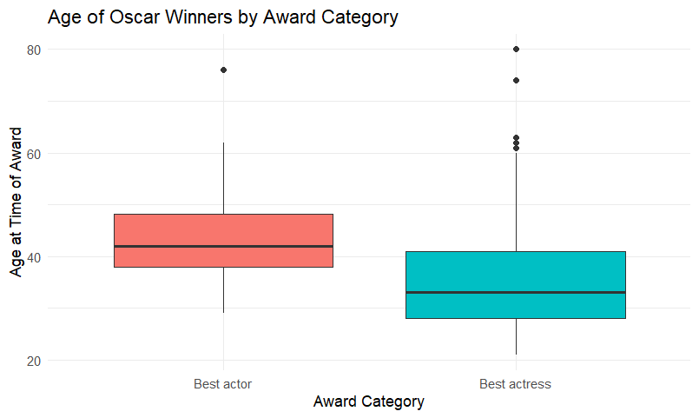



Summary & Visualization
Bar chart
(alternative representation)
Boxplot

Slide 9
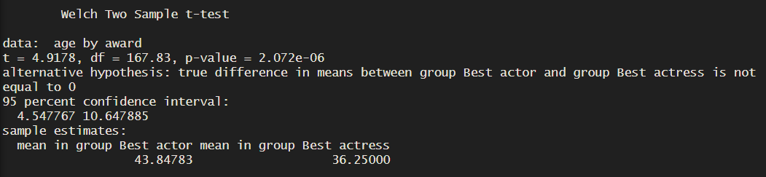
Analysis
Best Actor winners had a mean age of about 44.0 years (SD ≈ 8.9), while Best Actress winners had a mean age of about 36.2 years (SD ≈ 11.4). The gap between the two groups is roughly 8 years. Notably, the Best Actress group shows higher variability (larger SD), which means ages were more spread out, ranging from very young winners in their early 20s to women winning in their 60s and beyond.

Slide 10
Conclusion
In conclusion, we reject the null hypothesis. There is a statistically significant difference in the average age of Best Actor vs. Best Actress winners. Male winners tend to be awarded about 8 years older than female winners on average. The boxplot further reveals that the Best Actress distribution is more right-skewed with notable outliers (older winners), which suggests that while the average skews younger, some women do win at older ages.
Knowing that the null hypothesis is rejected, it remains to be seen whether this difference in average age correlates to the award’s time period. More specifically, does the difference in average age change
The impact of the result lies in its implications on gender bias. The fact that female winners are younger on average could suggest that youth is more valued in actresses than experience or skill.

Slide 11
Thank You

